Slide 1
CZ4034 Project Presentation
Cao Gaoxu
Chen Ziao
Liu Peng
Pan Jiangdong
Notes:
Welcome to CZ4034 Project presentation.
This is the outline of our presentation.
Firstly Introduction, Our group members are Cao Gaoxu, Chen Ziao, Liu Peng and Pan Jiangdong. This is a summary of works done by each group member.
Nowadays, people like reading news posted by famous news channels on Twitter. However, different people have different preferences on different news. For example, some people may prefer reading political news, others may prefer business news. The objective of our project is to build a web application that gets news from different news channels on Twitter and classify them into certain categories so that people can search for news they are interested in easily.
Right side would be the software and frameworks we have used in our project. The web application is built under Django Framework. Tweepy module is used to connect our application with Twitter API and sklearn packages is used to perform classifications on tweets. Indexing and querying are achieved using Solr Built-in functions.
For Crawling, we first crawl JSON format data from twitter API. The screenshot here shows the raw JSON data of one tweet retrieved from Twitter. Since we do not need all fields, we perform some preprocessing to retrieve certain columns we need.
These are the tweets data stored in Solr. Each tweet will just have a few columns such as content, name of news source, number of likes and number of retweets.
For indexing, since Solr provides a lot of powerful functions, so we decide to use Solr to perform indexing.
Indexing is performed on the content of each tweet. Functions used are: removing stopwords, lowercasing letters, stemming and NGram Filters
This is our web application, in the middle, we can see lots of tweets, on the left side, user select different category of news such as Business, Political, Social, Technology and other news. Besides that, user can also read news from different news channels such as CNN, BBCWorld, Straits Times, New York Times and Wall Street Journal. In addition, user can also click on the right side drop down box to sort the tweets, we can sort by time, sort by popularity which is number of likes and sort by number of retweets. Lastly, user can choose to update tweets to get the most current tweets from news channels. User can choose to update the news from one or multiple channels or just update all. For example, we can see that for BBCWorlds news, the newest news in our system is on April 7th. When we click on update, after a few seconds, the BBCWorld news is updated to be April 8th.
User can also search news based on keyword, for example, user input”Donald Trump” and press enter, system will retrieve news about Donald Trump for him. If user misspell the “Donald Trump”, the system will provide a suggestion on the misspell word and user may just click on it to correct his search input.
For Classification, we perform some preprocessing steps on the text before classifcation such as removing stopwords and stemming. All text will be converted into a document term matrix and we have also use td-idf conversion to give each document a relavance score. The tf-idf matrix is used to build a model.
We have tried different models to see which one gives the best performace. And we have found out that linear support vector classifcation model gives the highest accuracy, recall, F-measure and second highest precision, so we decide to use it as our final model. However, when we manually label the data, we found out that there are around 46% of tweets are political news, hence there are a potential sampling problem due to too many political news. We use undersampling techniquess, and based on the statistics, metrics in yellow are those improved by undersampling. Overall, undersampling improves our model.
There is also a potential overfitting issue, our model may fit the training data but not the new tweets from Twitter. Therefore, we perfom 10 fold cross validation on each model to see which model is truly useful. Based on the result, Linear support vector classififcation model has the highest cross validation score, which again further justify our choice on it as our final model. That is all for our presentation, thank you for listening, we hope you enjoy our presentationl.

Slide 2
Outline
Introduction
Crawling
Indexing
Querying
Classification

Slide 3
Introduction

Slide 4
Team Member
Crawling
Chen Ziao
Indexing and Querying
Chen Ziao, Pan Jiangdong
Classification
Cao Gaoxu, Chen Ziao, Liu Peng, Pan Jiangdong
User Interface
Chen Ziao, Pan Jiangdong

Slide 5





System Introduction
Situation:
People like reading news posted by famous channels on Twitter
People also have different preferences
Objective：
Classified news to different categories
Help user to search news on tweets by keywords
Provide function to sort the news according to different criterias

Slide 6
Crawling

Slide 7
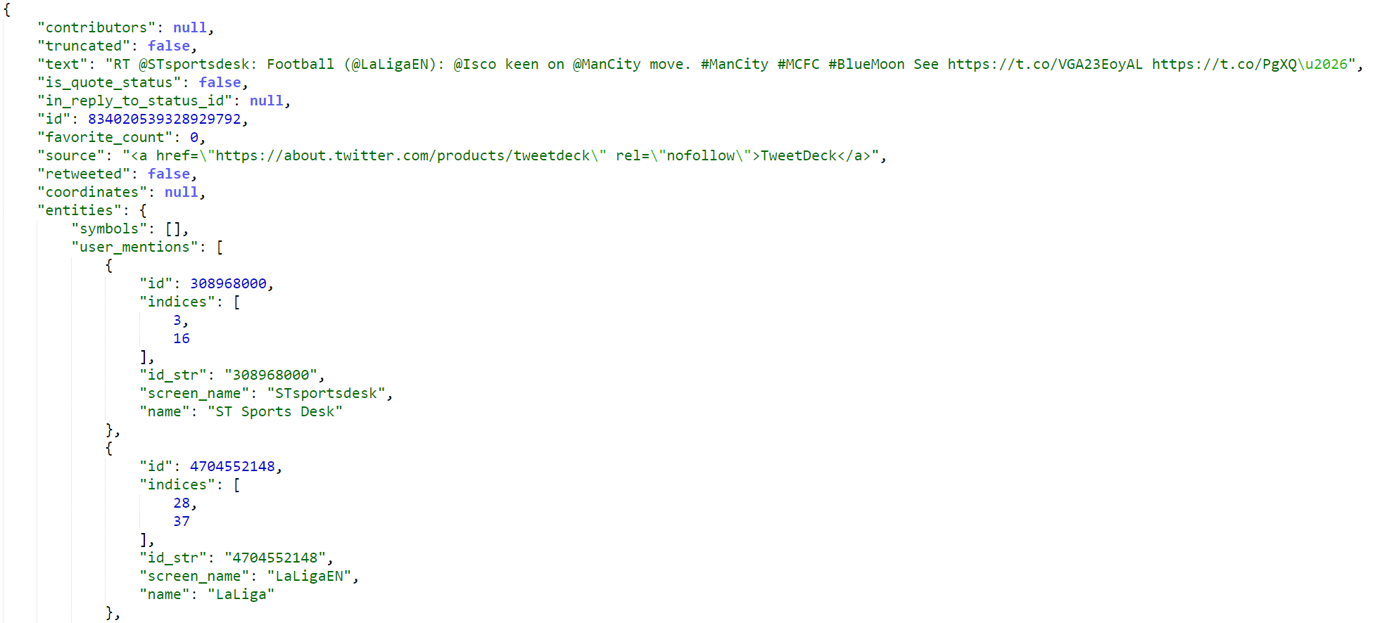
JSON Example

Slide 8
Indexing

Slide 9
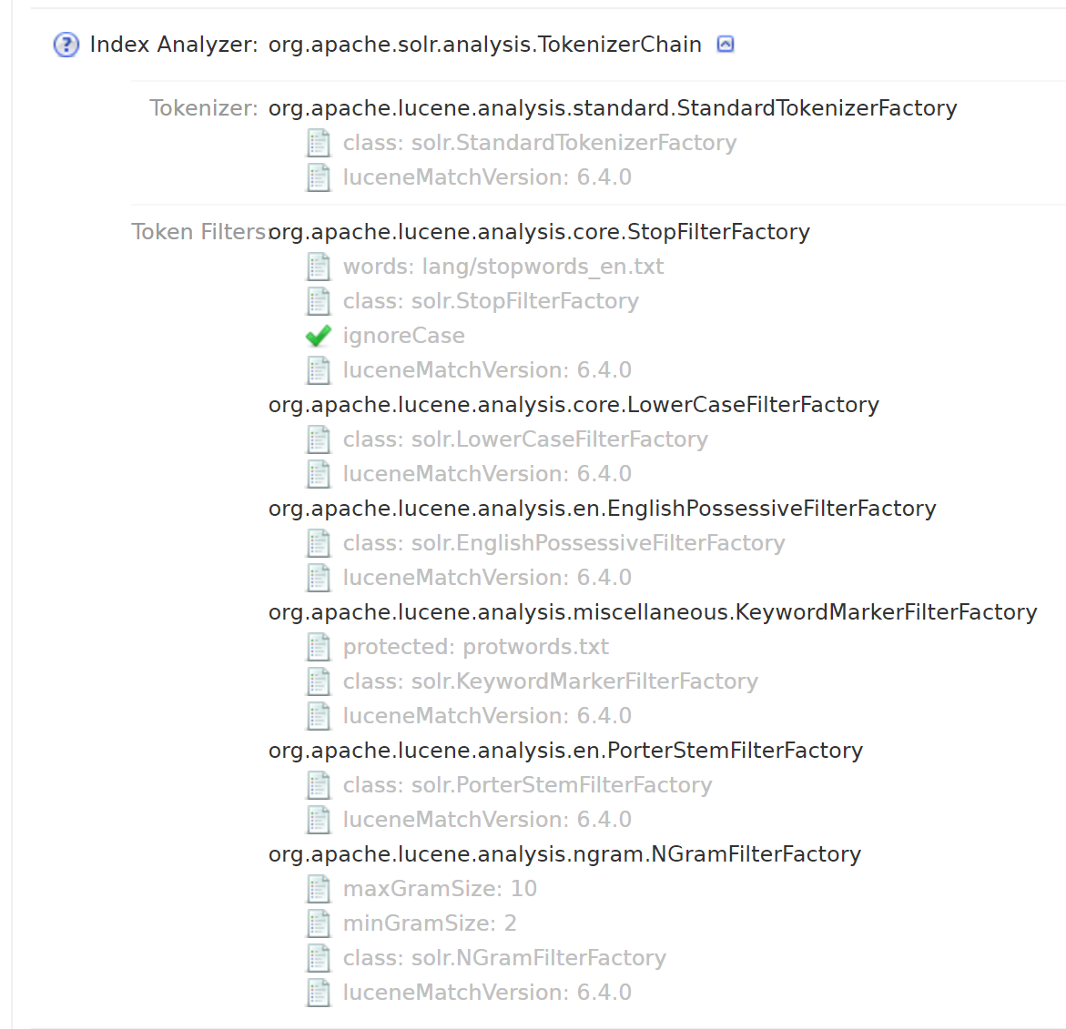
Solr Demo

Slide 10
NLP

Slide 11
Querying

Slide 12
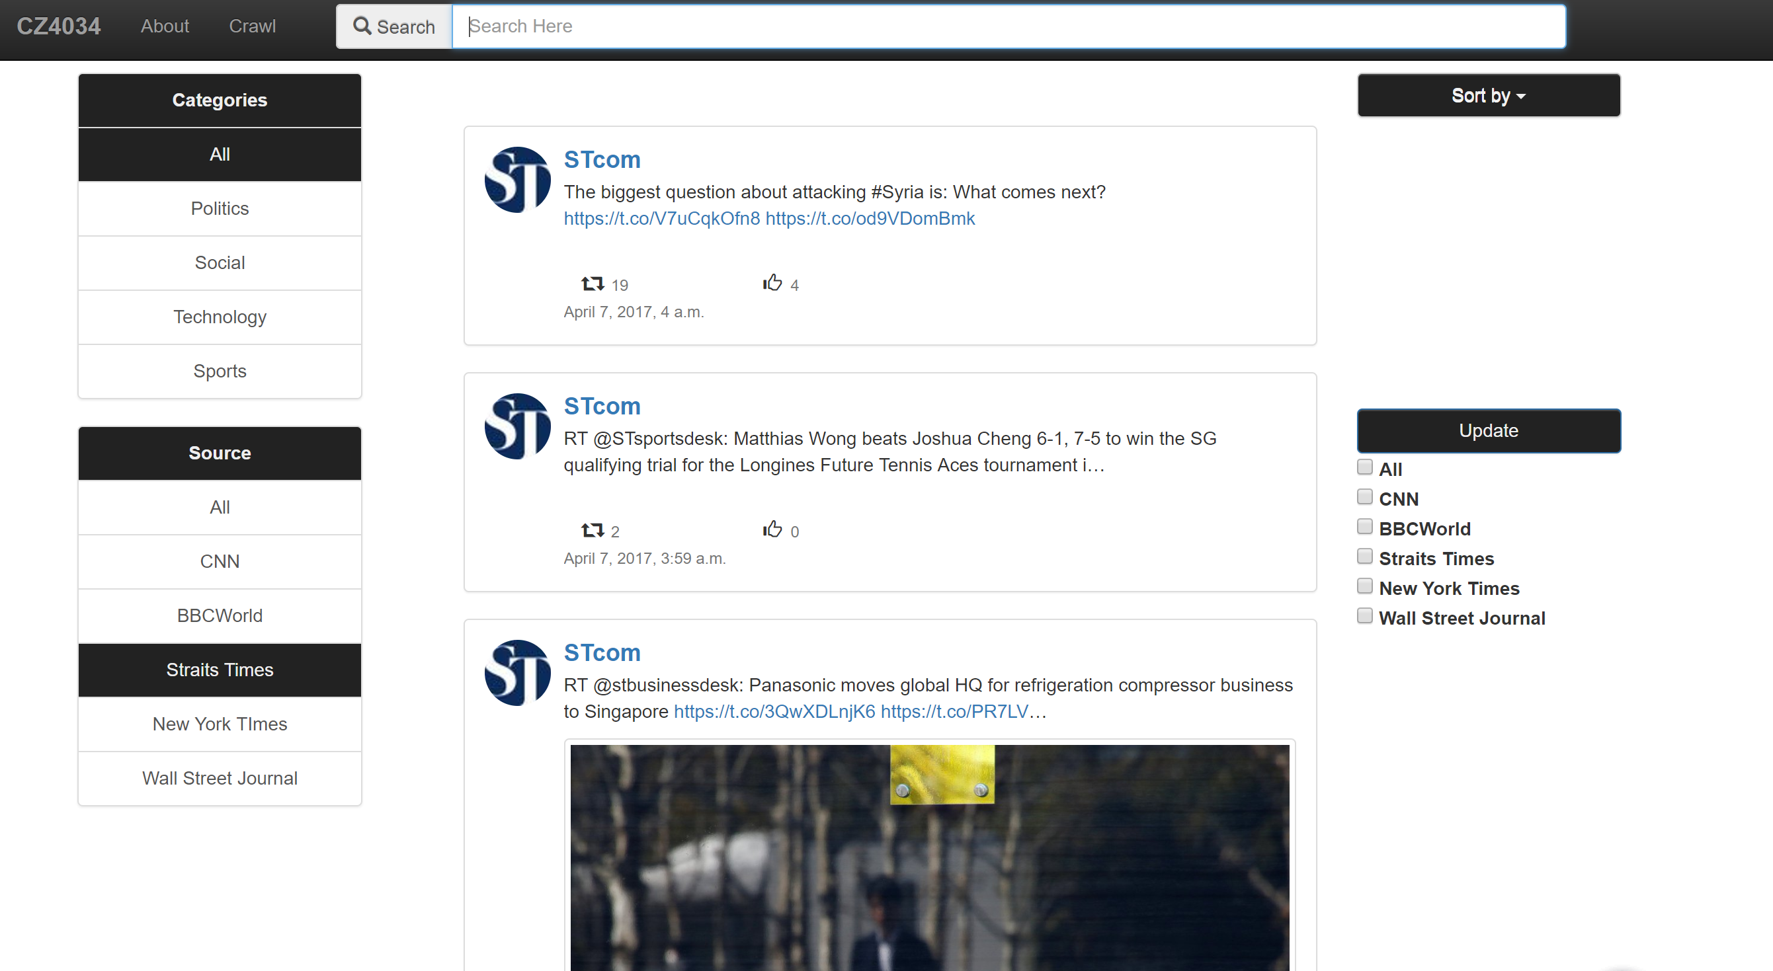
Django Application Demo

Slide 13
Classification

Slide 14
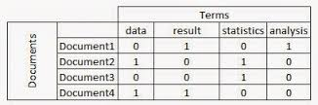
Pre-processing
Remove urls
Remove non-alphabetic characters
Convert to lowercase
Remove stop words
Stemming
Document-term matrix
Tf-idf matrix

Slide 15
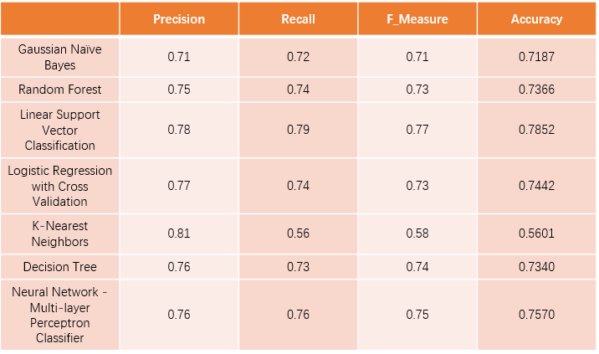
Model Comparison

Slide 16
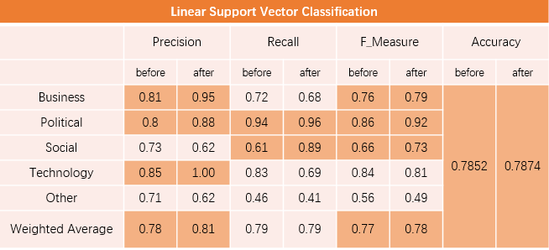
Classification
Undersampling

Slide 17
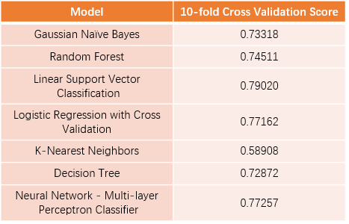
Overfitting Issue => Cross validation (10 fold)

Slide 18
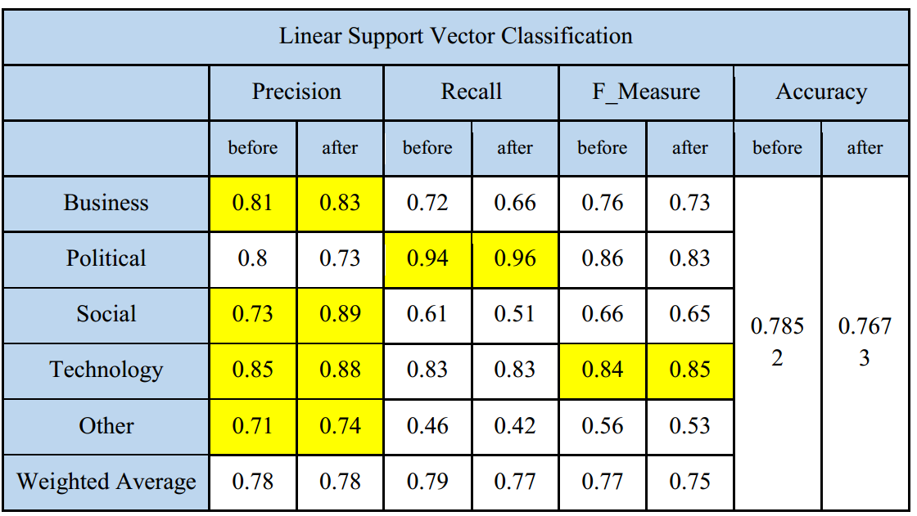
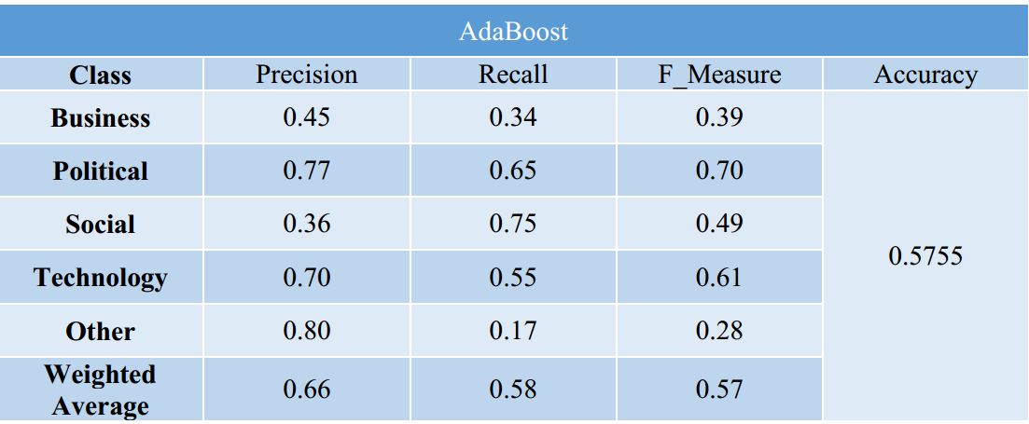
Ensemble Method
Bagging
Random Forest
Boosting
Notes:
We have used ensemble method.
First table is the result after implementing bagging classifer on Linear SVC Model. The result is very poor.
Random Forest Ensemble classifer also does not perform better than our final model
Lastly, adaboost classifer does not give a high F-measure
Therefore, we do not integrates ensemble methods in our system.

Slide 19
Thank you!

